Slide 1
Sprint Review
Sprint 2: Python WebScraping on a Virtual Machine

Slide 2
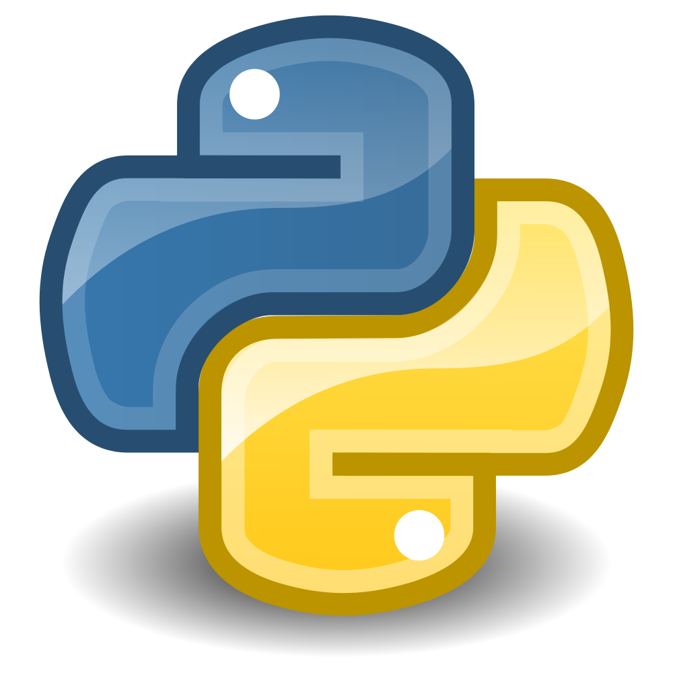
Notes:
The first is creating my virual machine droplet, the second is installing jupyter notebook onto it, and the third was writing a python script within it

Slide 3

Notes:
What is digital ocean? Cloud server, basically its my new computer, but I don’t really have a desktop interface to work on it with

Slide 4
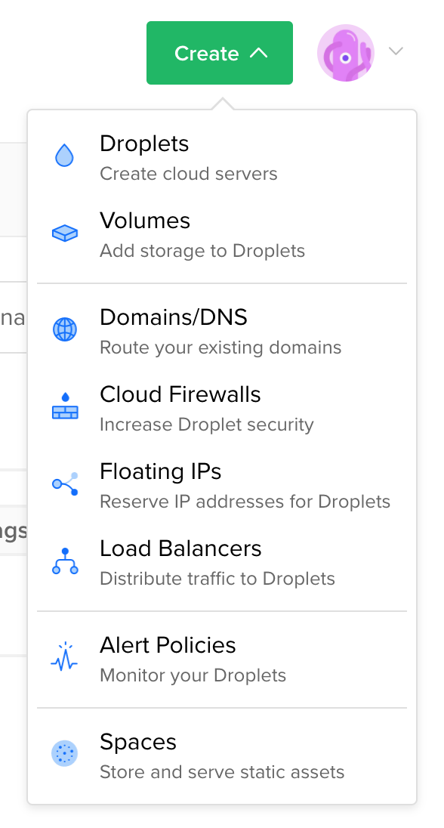
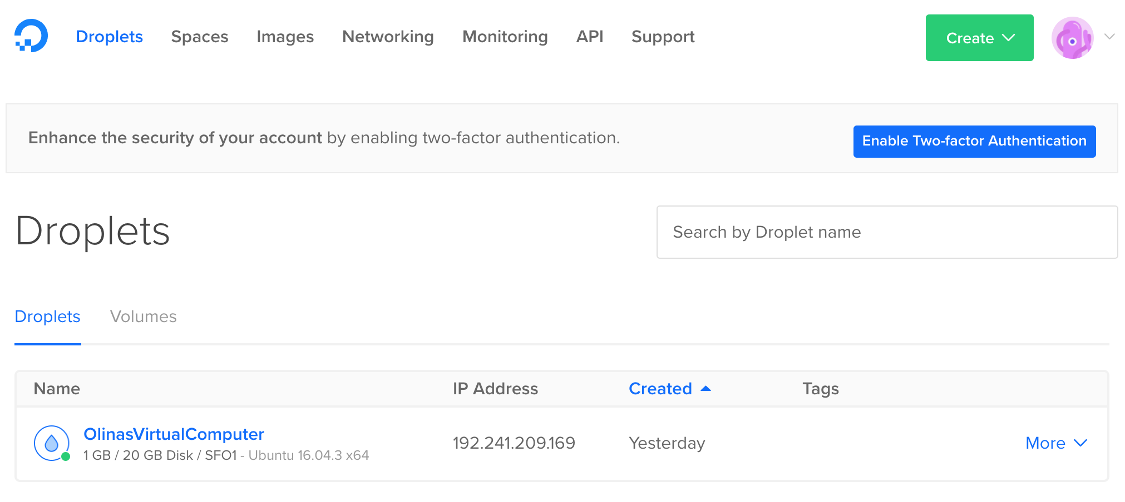
Notes:
Installing digital ocean

Slide 5
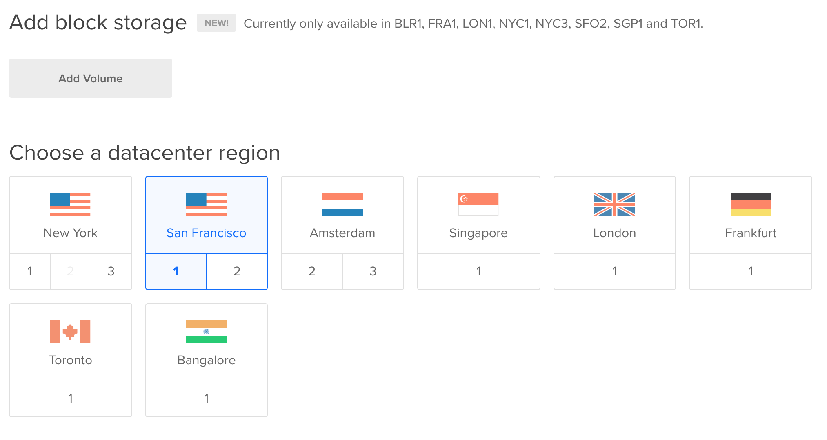
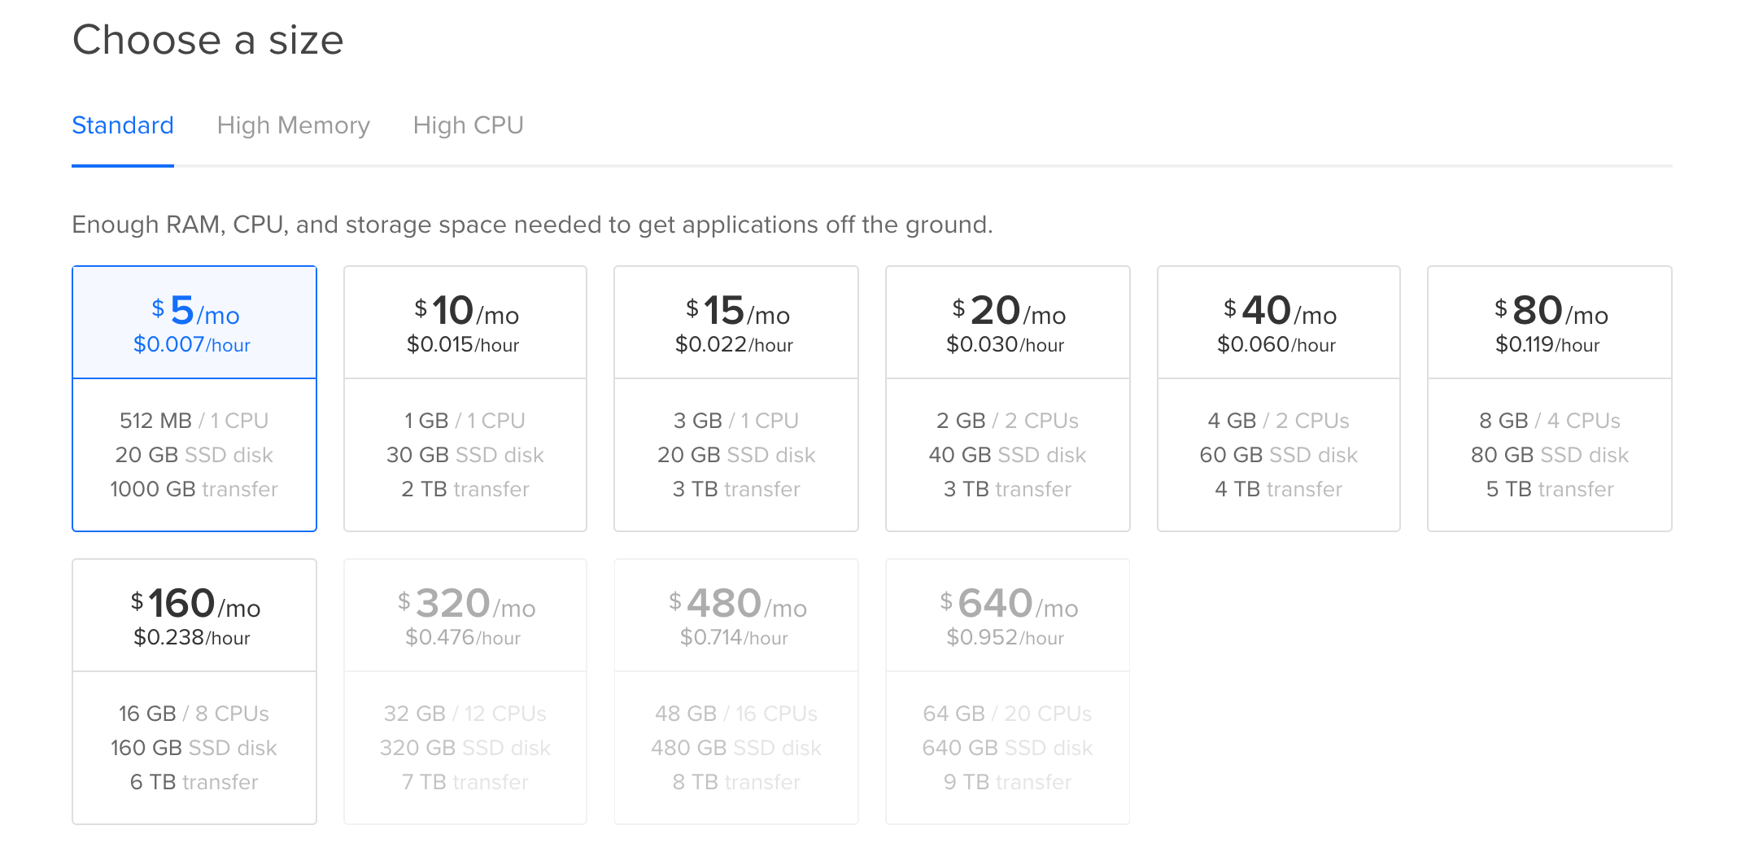
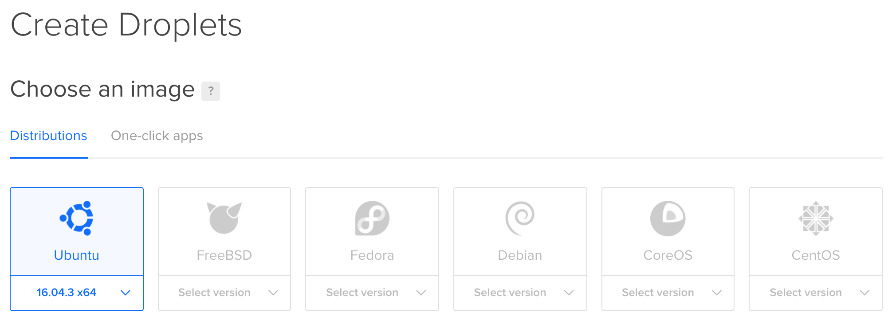

Slide 6

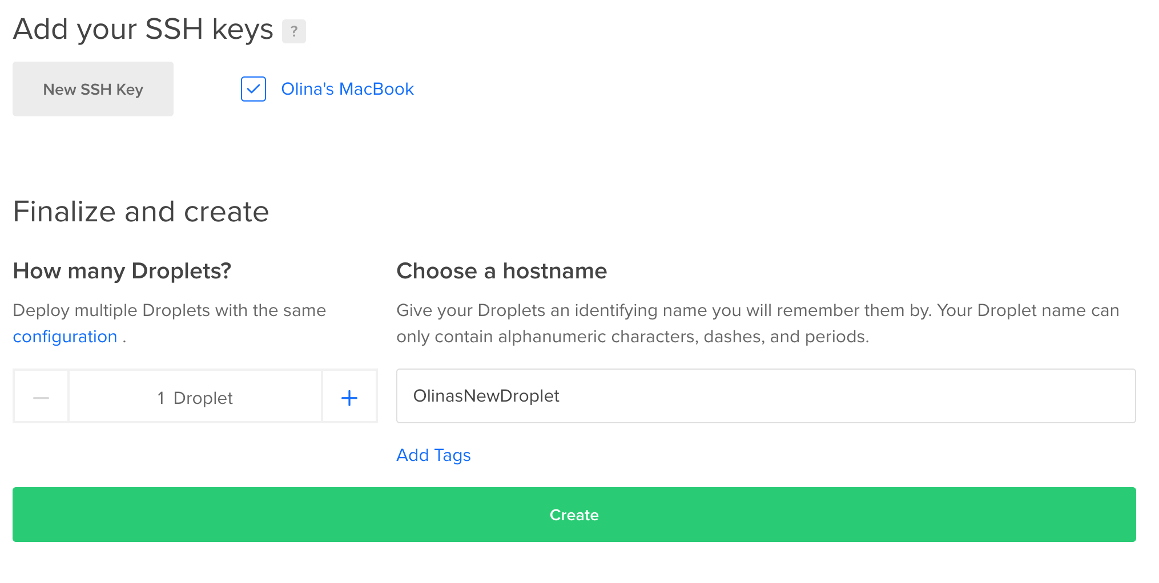
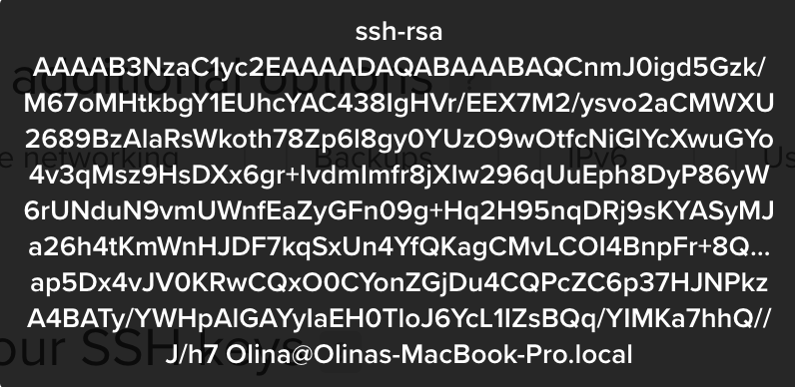

Slide 7
Notes:
How to install jupyter notebook to run ipython

Slide 8
http://192.241.209.169/tree/Work
Notes:
For the data that Rstudio returned to me from the Depth Chart website, I copied and pasted it into excel, and this is how it was originally formatted. As you can see, the code from Rstudio returned 36 lines of data.
If you look through it, you eventually realize that the original HTML coding on the website is a little funny and it duplicates some of the data, and it also includes some extra information that wasnt useful to me, so the next step was to clean and format my data.

Slide 9
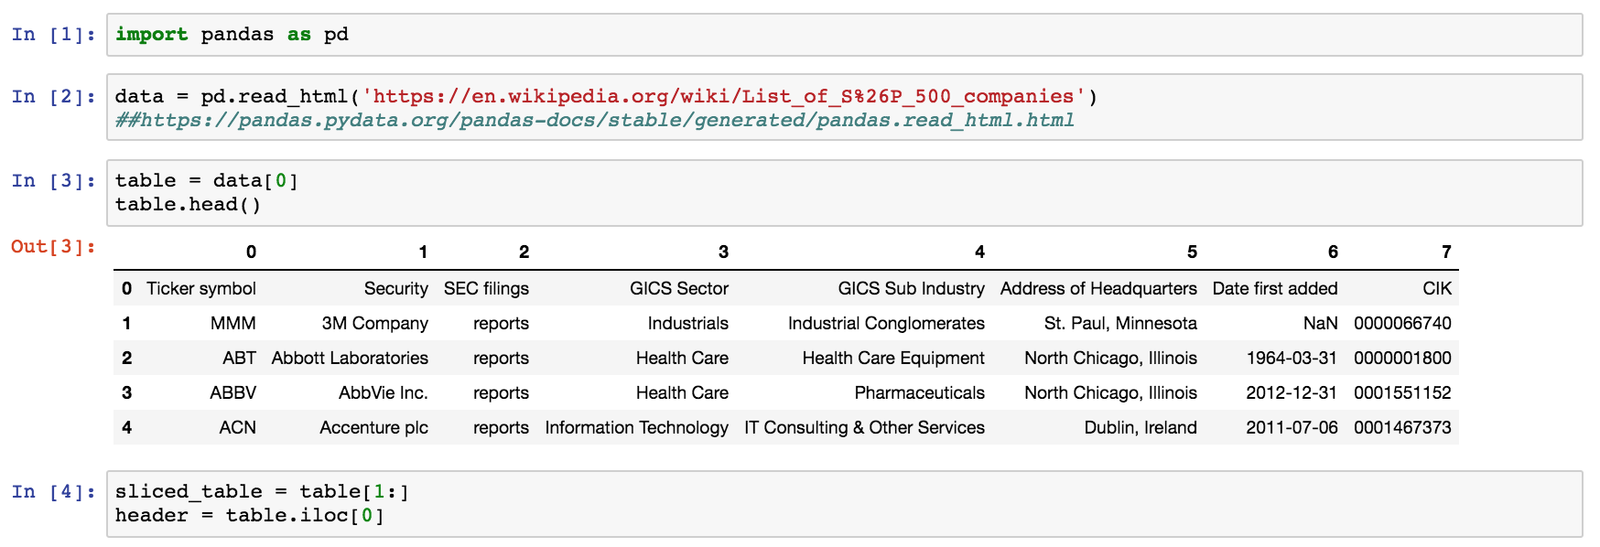

Slide 10
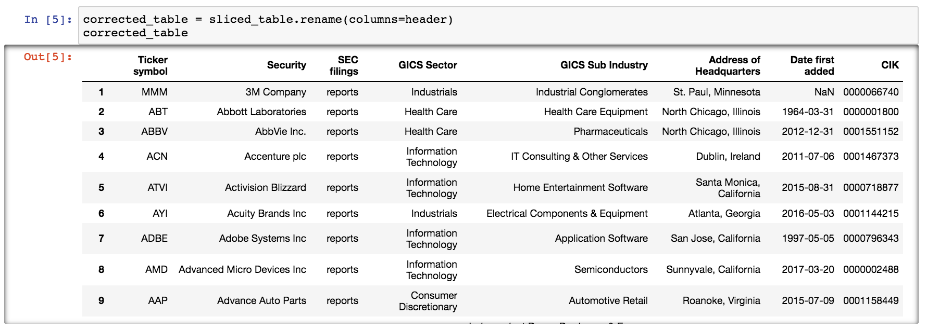

Slide 11
Thoughts…

Slide 12
Fin

